Slide 1
Identifying Fraudulent Bank Account Applications
Final Project Presentation
Bruce McGregor, Katherine Sejas, Michelle Wu

Slide 2
Introduction/Problem Statement
Problem: Identifying fraudulent bank account applications, such as ones based on stolen identities or with false information. This adversely impacts the victim’s (whose identity was stolen) ability to then later open bank accounts and obtain credit.
Based on the FTC Consumer Sentinel Network Data Book 2023 - there were over 1 million identity theft related reports filed.
Machine learning is being used in fraud prevention and detection by analyzing large quantities of data to identify patterns. The machine learning models are trained on historical data to be able to recognize fraud patterns and then applied to regular bank accounts to flag potential activity as fraud.

Slide 3
Data - Bank Account Fraud Dataset Suite
Data obtained from Kaggle
Synthetically generated by a generative model (CTGAN) that was trained on real-world anonymized bank account opening fraud data
1 million observations
30 predictor variables: income, employment status, credit risk score, housing status, application month, etc.
5 variables are categorical, while the rest are numeric
Our models utilize the “fraud_bool” field as our response variable. It is an indicator variable, which is equal to 1 if the bank account opening application is fraudulent and equal to 0 if it is not fraudulent, thus a legitimate bank account application.
The data is imbalanced.
Only 1.1% of transactions has fraud_bool equal to 1.

Slide 4
Methods and Model Structure
All modeling experiments used a split of 70% training and 30% testing. Some experiments were run on a sample of the data, while others on the whole data depending on the type of experiment.
For experiments 1-3 we used PyCaret Library to run 15 different model types: Logistic Regression, K Neighbors Classifier, Ridge Classifier, Random Forest Classifier, Extra Tree Classifier, Dummy Classifier, SVM Linear Kernel, ADA Boost Classifier, Extreme Gradient Boosting, Gradient Boosting Classifier, Light Gradient Boosting Machine, Linear Discriminant Analysis, Decision Tree Classifier, Naive Bayes, and Quadratic Discriminant Analysis. (Run on Google Collab)
For experiments 4-8 we switched to using the scikit-learn python library. (Run on Local Computer)
Metric using to evaluate our models is the F1 score since both false positives and false negatives are costly. A false positive would deny a person from opening a bank account when there is no fraudulent intention, while a false negative would approve opening a bank account for a person with fraudulent intention, therefore to balance out both of these concerns we are using the F1 score instead of just either recall or precision.
Please see our github readme for a detailed explanation of each experiment.

Slide 5
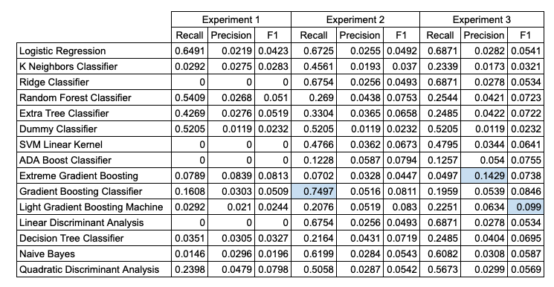
Model Type Selection Experiments 1-3
Recall, Precision and F1 Scores based on the Fraud_Bool = 1 values not the weighted average across Fraud_Bool values
High recall value but with a low precision and F1 value
Gradient Boosting Classifier from Experiment 2 had the highest recall value = 0.7497
Top Model Types Chosen for Experiments 4-8: Gradient Boosting Classifier and Logistic Regression

Slide 6
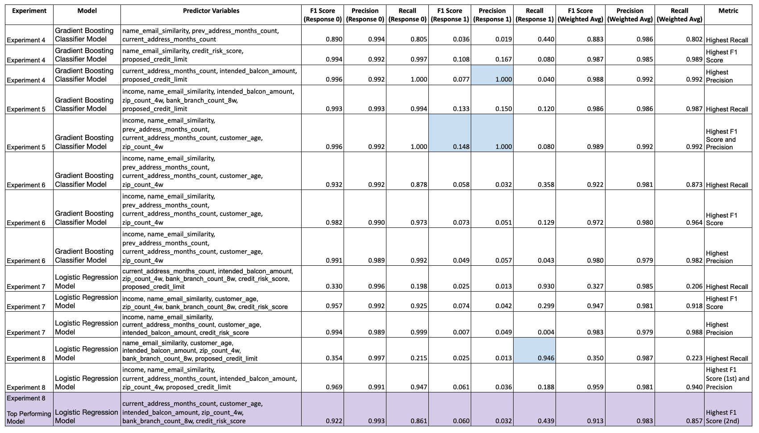
Model Tuning Experiments 4-8
These experiments focused on tuning various hyperparameters along with variations in features selected
Top Performing Model is a Logistic Regression Model: achieved an F1 Score (weighted average) of 0.913

Slide 7
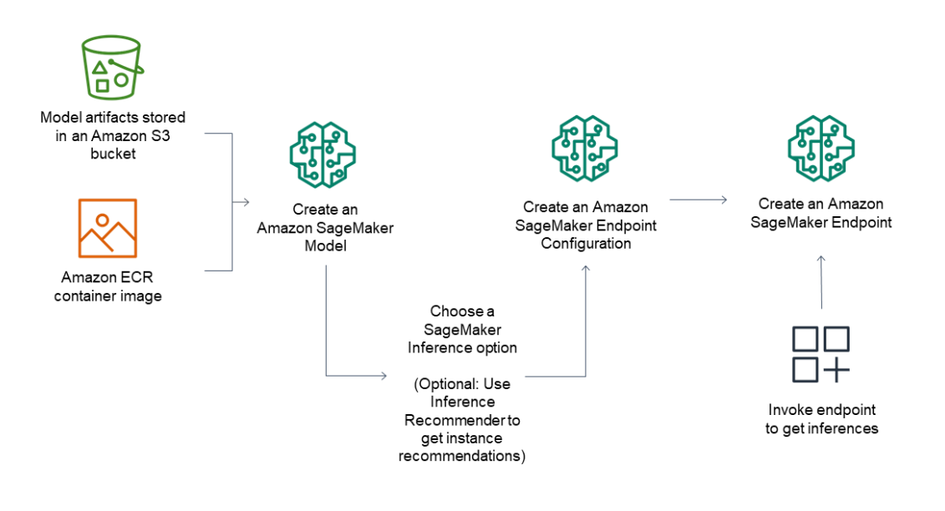
SageMaker Studio Model + Inference
Deploy a SageMaker Studio Model that was trained on Google Colab
Run real-time inference with the deployed model

Slide 8
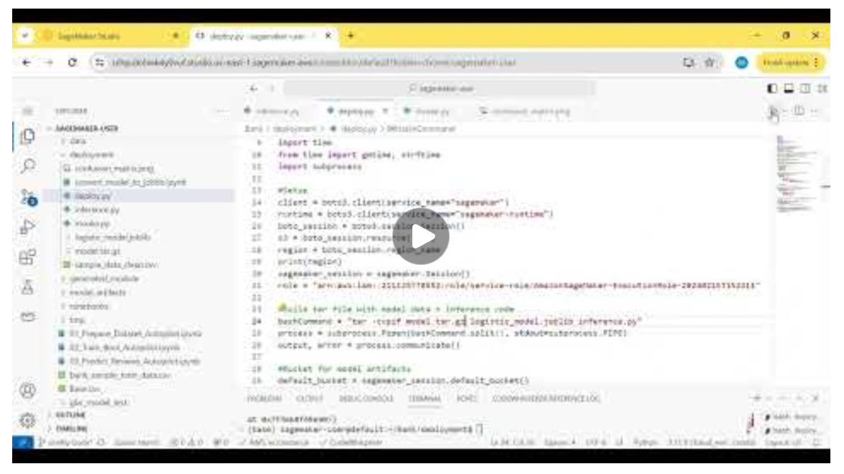
Inference Demo
Notes:
For the video of our demo, please see our canvas video submission.

Slide 9





Use Case 4: AWS Services and Applications
For our use case, we used the following AWS services to facilitate building a fraud detection model.
AWS S3 for data lake storage
AWS Lake Formation for data access control
AWS SageMaker Autopilot to optimize fraud detection model (hyperparameters)

Slide 10
Exploration of AWS Auto ML - Canvas
Our learning objective was to understand the advantages of using AWS AutoML compared with the traditional custom model development process in the context of the bank fraud detection use case.
For our project we explored the AWS Sagemaker AutoML Canvas service to understand how it could be applied to develop a fraud detection model from our data set.
The AutoML Canvas provides a simple and intuitive user interface for automatically building a fraud detection model from our sample data set

Slide 11
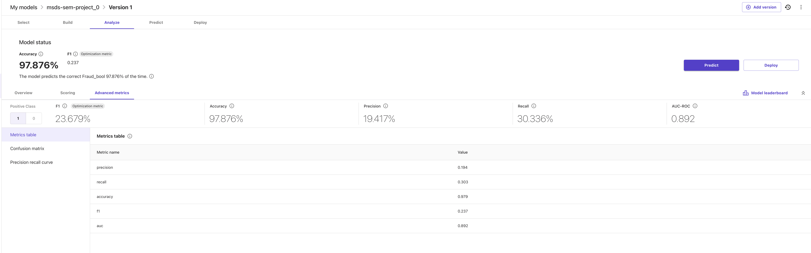
Model Results
XG Boost Algorithm
FI - .189
Accuracy - 0.975

Slide 12
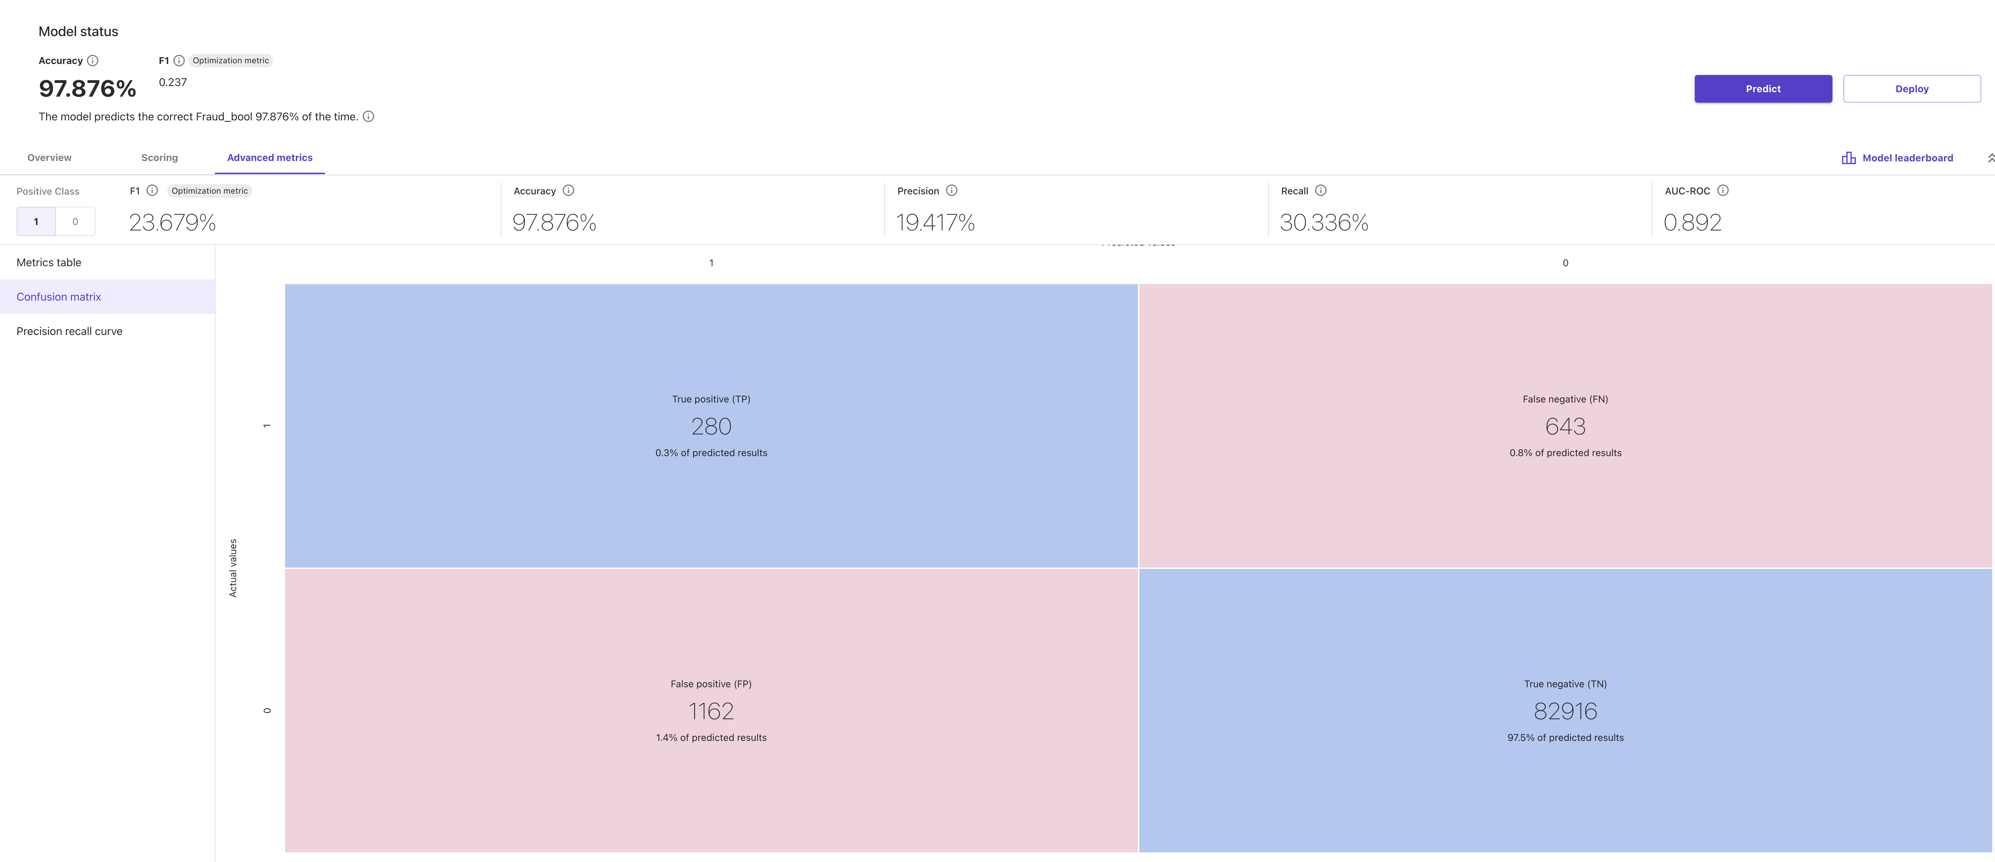
Confusion Matrix

Slide 13
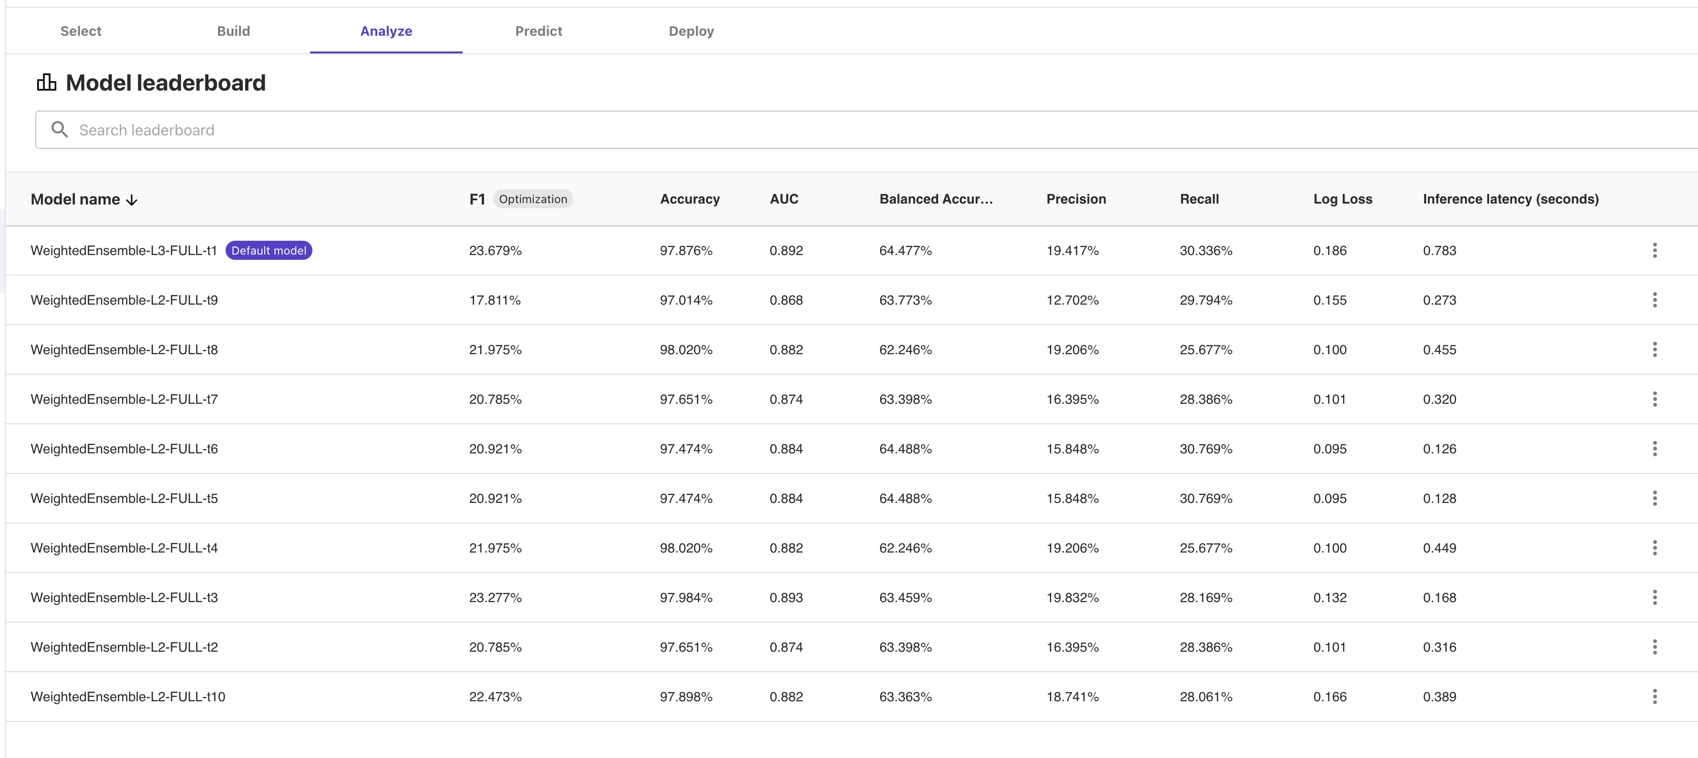
Model Leaderboard

Slide 14
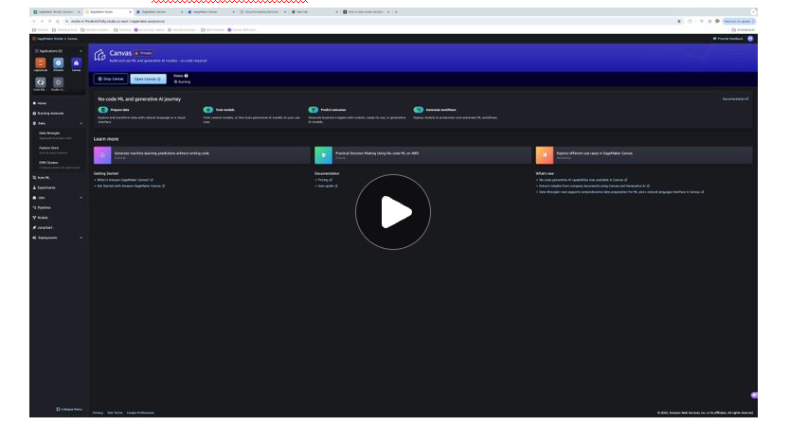
AWS AutoML Demo
Notes:
For the video of our demo, please see our canvas video submission.

Slide 15
Results Comparison
Inference
Predictor Variables: 'current_address_months_count', 'customer_age', 'intended_balcon_amount' 'zip_count_4w', 'bank_branch_count_8w', 'credit_risk_score'
Recall: 1
Precision: 0.855
F-1 Score: 0.91
AWS Studio Classic
Predictor Variables: name_email_similarity, intended_balcon_amount, days_since_request, velocity_6h, device_os, velocity_24
Recall: 0.62
Precision: 0.147
F-1 Score: 0.189
AWS Sagemaker Canvas
Predictor Variables: Prev_address_months_count, current_address_months_count, device_os, phone_home_valid, email_is_free, keep_alive_session, has_other_cards, housing_status, income
Recall: .303
Precision:0.194
F-1 Score: .237

Slide 16
Conclusions
Overall
Model results were superior using custom model development compared to AutoML
Use of 6 predictor variable yielded the best results from the overall 30 variables
Simple process to integrate custom model into AWS SageMaker Studio Inference Pipeline
Advantages of using AWS vs Traditional Model
Simple, intuitive interface that requires no coding to get a model up running quickly
AWS selects the best algorithm based on the use case (e.g., 2 category prediction)
Fully automates process of splitting data set, model building and tuning
Runs many different combinations of hyper parameters and provides you with a top performing model
Easy to run manual and batch predictions
Simple model deployment
Disadvantages AWS vs Traditional Model
Costly using AWS environment to run everything inside AWS
Less control over the algorithm choice and hyper parameter choices

Slide 17
Thank you!
Questions?

